Slide 1
BSC4943r Project
Presentation by Julian McKinley

Slide 2
Introduction

Slide 3
Genetic Terms
Gene
The fundamental element of inheritance transmitted from one generation to the next
DNA molecules carry the genetic material and make up genes
Genome
The complete set of genes or DNA in an organism
Genomics: Study of genes and associated DNA sequences within genomes
Transcriptome
The complete set of RNA molecules or “transcripts” in an organism
Transcriptomics: Study of genes and associated RNA molecules within transcriptomes

Slide 4
The omics: Genomics and Transcriptomics
Genomics help us to understand the genome as a whole by mapping genes at the DNA level
Transcriptomics provides insight on the expression and repression of genes by analyzing RNA sequences and can be used to study non-model plants and other organisms
For this project, a transcriptomic approach to better understand RNA gene regulation at the chromatin level in the plant species, Zea Mays, will be considered

Slide 5
Plant Genetics
Plant genomes are very different than human or mammalian genomes
Larger and more complex
High ploidy levels
Repetitive sequences
Frequent genome rearrangements
There are lots of human and mammalian omic (genomic/transcriptomic) studies but not as much research or funding for plant genetics
The Human Genome Project
However, there has been rapid increase in genomic sequence data in numerous plant species including Zea Mays
Next-Generation Sequencing (NGS) Technologies
Illumina
pacbio
Cost effectiveness

Slide 6
Comparative Omic Studies
Increase in data allows for comparative genomic and transcriptomic studies
Using available sequence data from plant species like Zea Mays, we can model other species with very well-known genomes, such as human genomes
Using Zea Mays as a model system with fully assembled genomes of other species, can reveal unknown information about plant genomes
More specifically, it can help us understand the Zea Mays transcriptome and the transcripts associated with gene regulation via chromatin remodeling

Slide 7
Background

Slide 8
Central Dogma
DNA RNA Protein

Slide 9
RNA/Protein Synthesis
Three primary RNA molecules associated with translation/protein synthesis:
mRNA
produced from DNA and carries the genetic instructions for protein synthesis
tRNA
provide amino acids for translation to take place
rRNA
responsible for the structure and catalytic activity of ribosomes, where protein synthesis ultimately takes place

Slide 10
RNA/Noncoding RNA (ncRNA)
ncRNAs refers to RNA sequences that do NOT encode for proteins
3 primary RNA molecules for translation/protein synthesis:
Coding:
Refers to mRNA
Noncoding:
tRNA
rRNA
However, some ncRNAs have regulatory functions that are completely separate from translation

Slide 11
Long non-coding RNAs (lncRNAs)
Typically exceeding 200 nucleotides in length
Found in both the nucleus and the cytoplasm
Roles in modifying chromatin structure/regulating gene expression both during transcription and after transcription has occurred

Slide 12
ncRNAs/lncRNAs
Why study them?
ncRNAs overwhelm the human transcriptome, whereas only 1-2% of RNA sequences encode for proteins
Researchers have only identified some ncRNA functions, such as epigenetic regulation in lncRNAs, but not all
Difficulties
Difficulties in understanding lncRNAs and how they exert their regulatory functions, are due to their complex nature
Means of conservation not understood, have unique roles in various cellular processes, are expressed at low levels, have varying subcellular localizations, and have functional redundancy

Slide 13
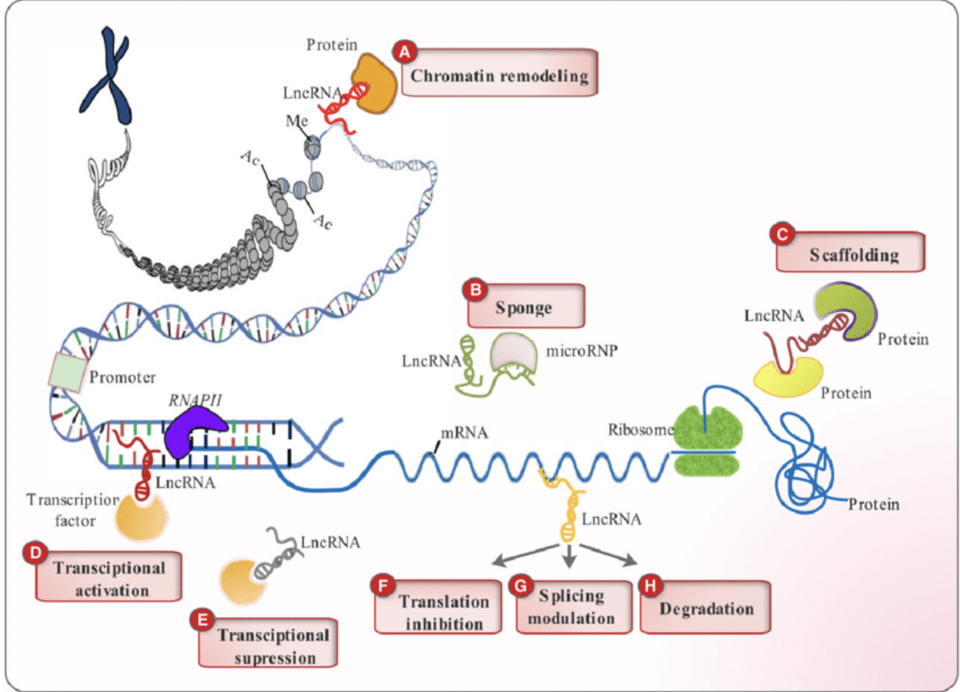

Slide 14
RNA Binding Proteins (RBPs)
In order to better understand lncRNAs, researchers have recognized the role of RNA-binding proteins (RBPs) and how they can provide valuable insights into the functions of lncRNAs
RNA-binding proteins (RBPs)
Set of proteins that bind to several classes of RNA molecules
Essential for RNA metabolism and RNA function
Understanding the interactions of specific RBPs and specific lncRNAs can help give us insight on the types of regulation being applied
Therefore, RBPs that assist in lncRNA gene regulation through chromatin remodeling in Zea Mays will be the basis of this research project to identify

Slide 15
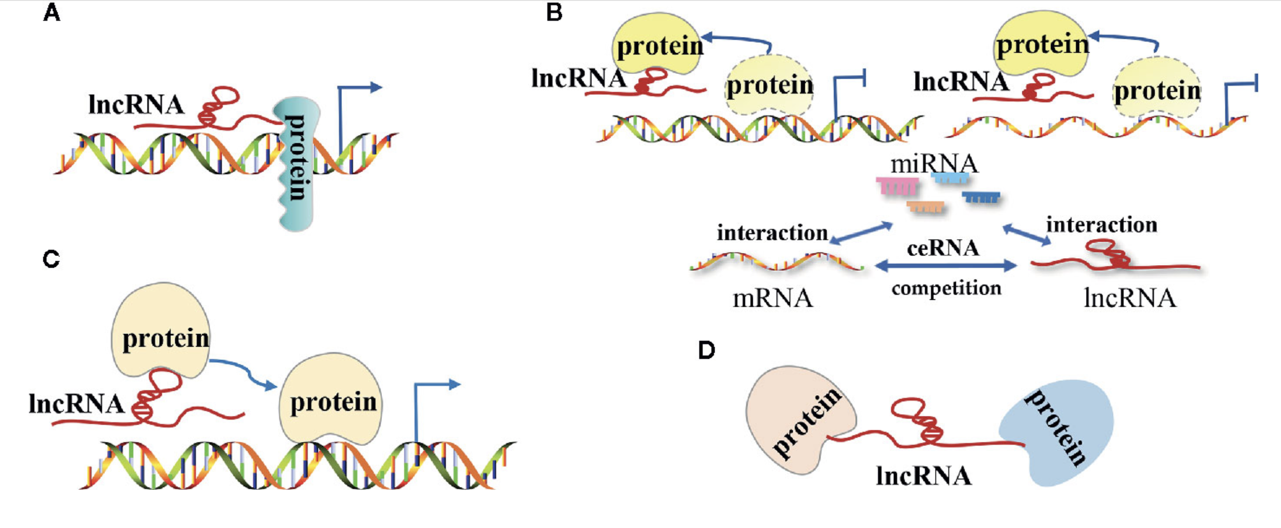

Slide 16
Chromatin Remodeling
Necessary for regulating gene expression, it refers to the dynamic changes in the structure of chromatin, the complex of DNA and proteins (histones) that make up chromosomes
These change of states allow access to DNA, enabling transcription, replication, repair, and recombination.
lncRNAs bind to specific RBPs that influence chromatin states and therefore regulate gene expression
Recruit RBPs that form chromatin-modifying complexes directly changing states
Interact with RBPs that prevent the formation of protein complexes
Form chromatin loops by binding to proteins

Slide 17
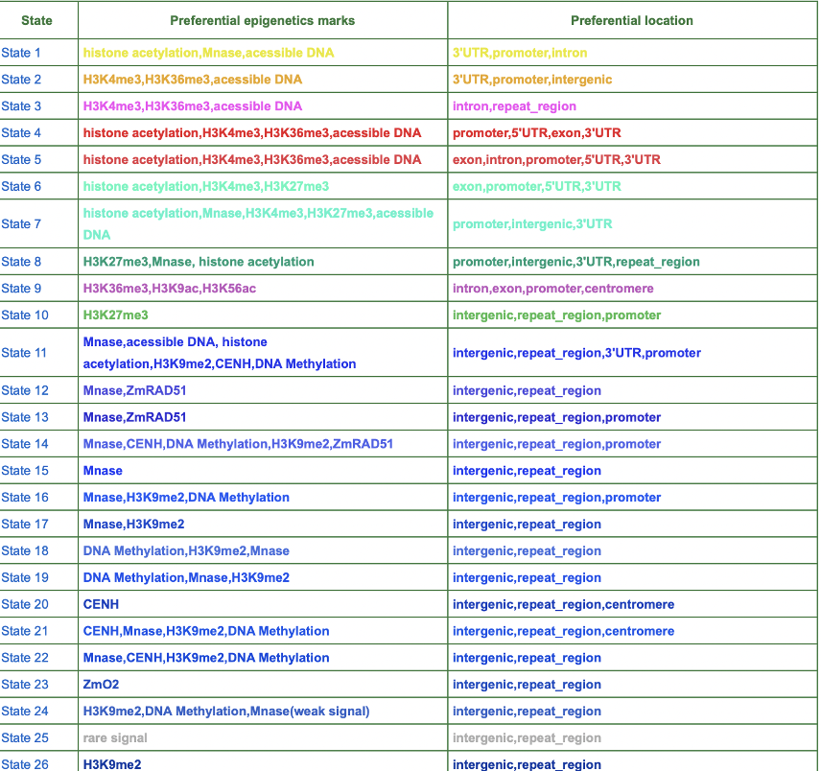

Slide 18
Analysis

Slide 19
Deep Learning
Using deep learning tools such as BERT-RBP, we can accomplish the task of understanding lncRNA and RBP interactions
More specifically, BERT-RBP can be used to model lncRNA and RBP interactions involved in chromatin remodeling and reveal the nature of these interactions in Zea Mays

Slide 20
BERT (Bidirectional Encoder Representations from Transformers)

Slide 21
BERT-RBP
Incorporates the use of a pretrained model known as DNABERT, which is trained on the human genome and can be fine-tuned for specific tasks.
It is fine-tuned to predict the binding affinities of RBPs and RNA molecules.
It requires the training of human CLIP-seq (crosslinking immunoprecipitation) data.

Slide 22
BERT-RBP Architecture
Takes an input RNA sequences which are split into 3-mers and tokenized, then converted into a 768-dimensional feature vector.
These vectors undergo processing through 12 transformer encoder layers determining if the input RNA sequence binds to the RBP.

Slide 23
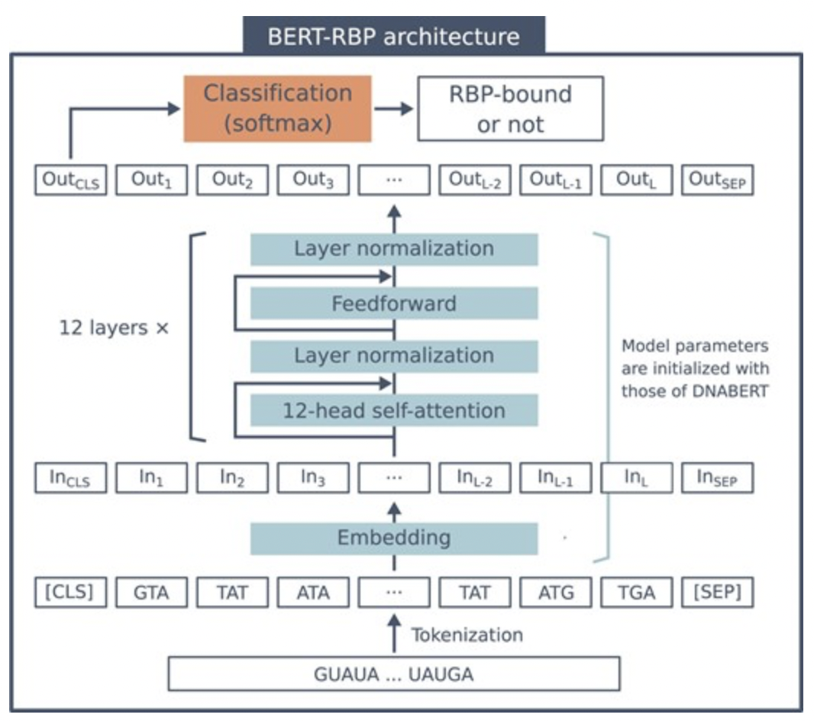

Slide 24
Predict the interactions between specific Long-Noncoding RNAs and RNA Binding Proteins That Cause Gene Regulation Through Chromatin Remodeling in Zea Mays
Goal:

Slide 25
Experimental Plan

Slide 26
Data/Data Preparation
A .gtf file that consists of a list of lncRNAs and associated gene IDs in Zea Mays will be processed and prepared for the mapping of chromatin states
Removal of duplicates
Ensure the correct gene ID format for data base used for mapping

Slide 27
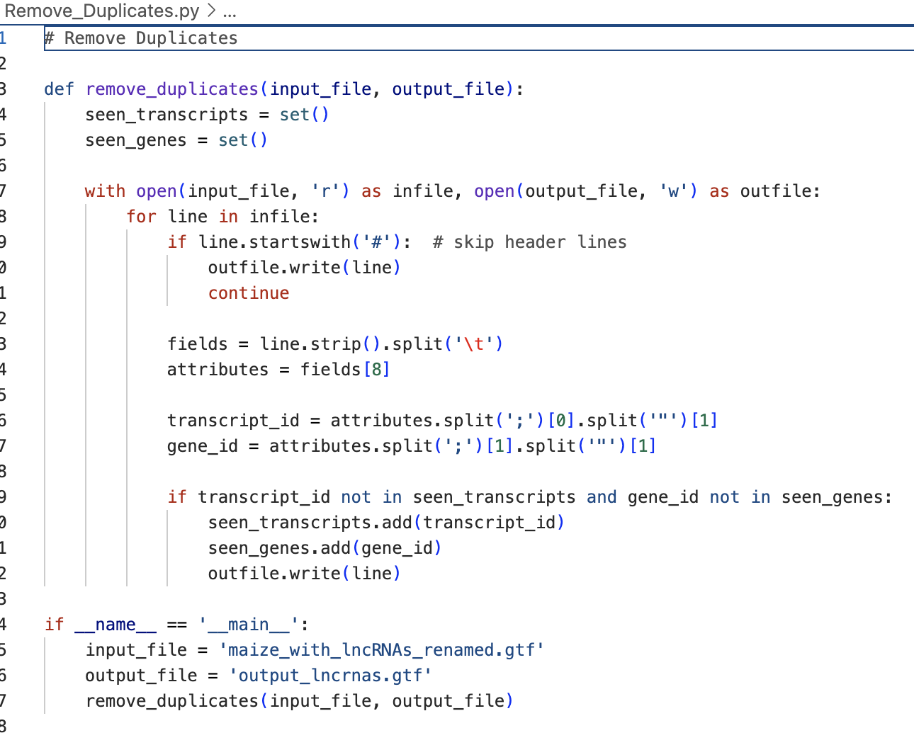
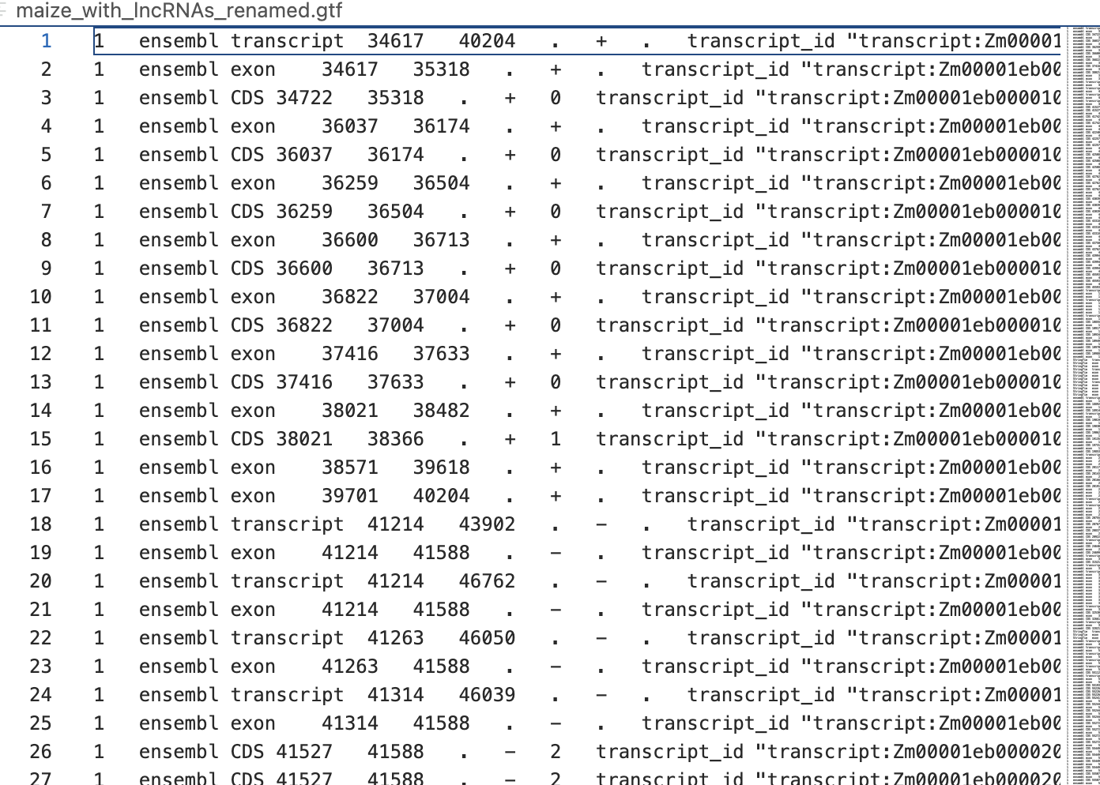
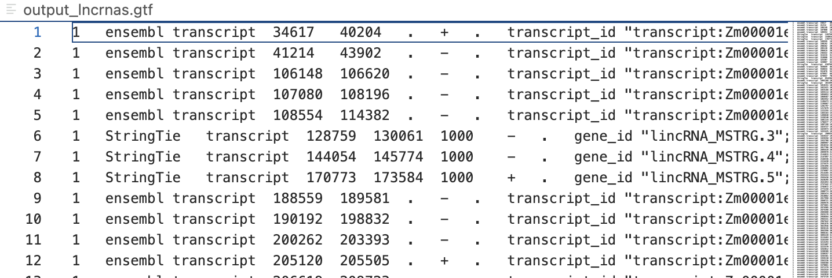

Slide 28
Mapping
List of lncRNAs need to be mapped to their associated chromatin states

Slide 29
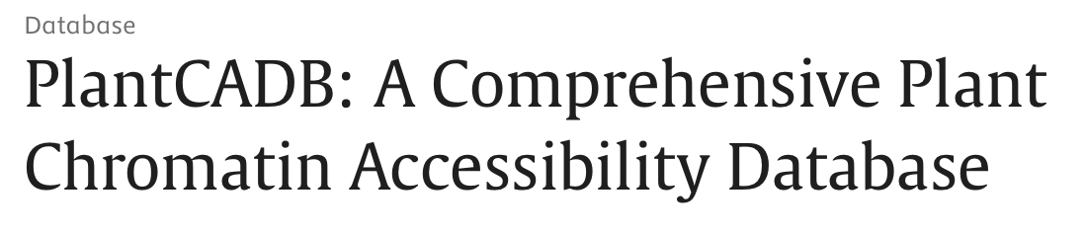
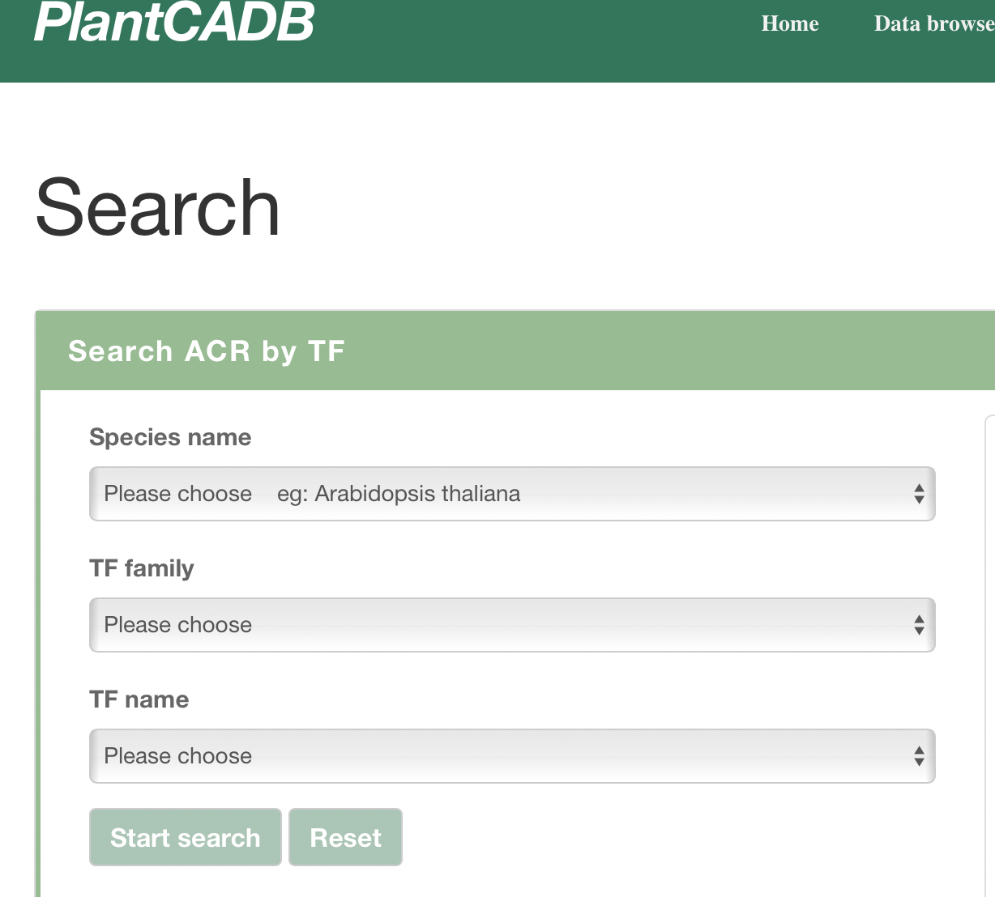
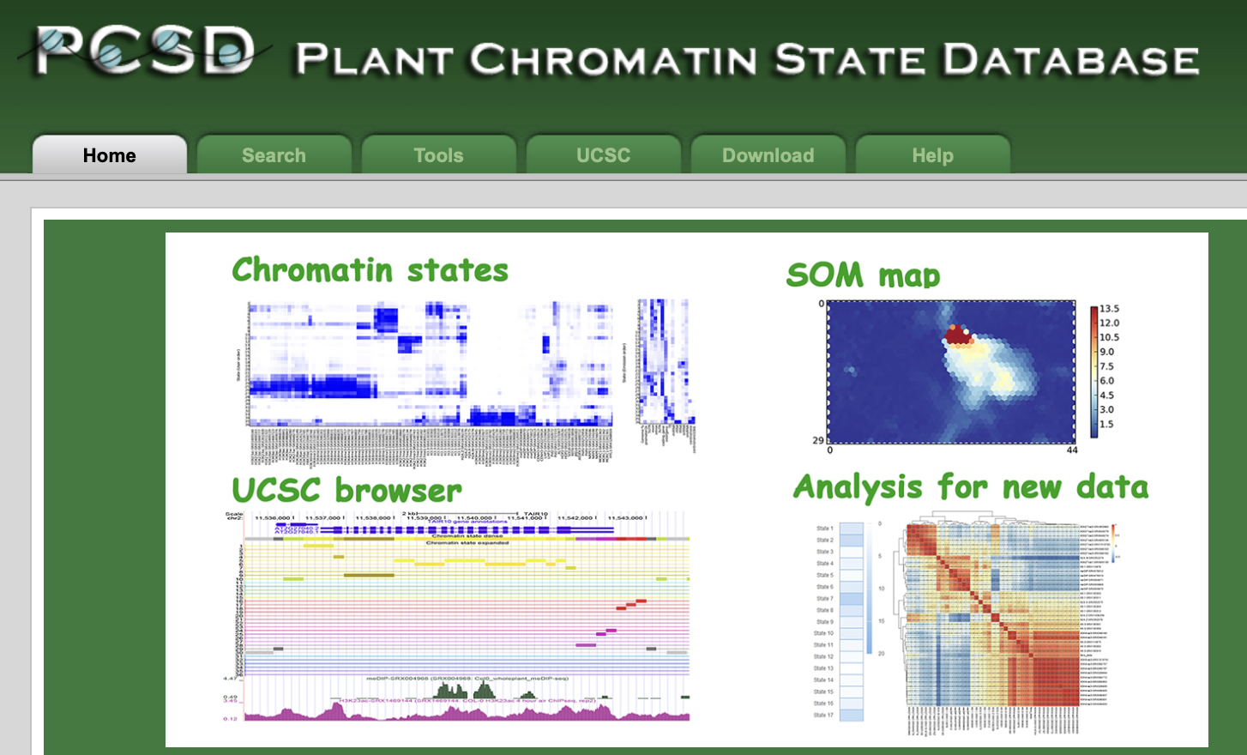
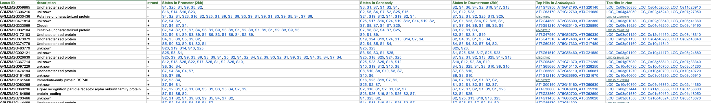

Slide 30
lncRNA and RBP subsets
Once all lncRNAs are mapped and its understood how they are distributed across the chromatin states, an analysis must be performed to determine subsets for lncRNAs and RBPs
Chromatin states will be narrowed down so that only a few are considered
Subset of lncRNAs and RBPs associated with those few chromatin states will be made for BERT analysis

Slide 31
Application of BERT analysis
Once the subsets of lncRNAs and RBPs are determined through thorough analyzation, BERT-RBP will be used to test the probability of these specific lncRNA and RBP interactions
Since BERT-RBP is trained on CLIP-seq data for the human genome and there isn’t CLIP-seq data for Zea Mays, a comparative transcriptomic approach is being applied as part of the analysis
The human CLIP-seq data will model where lncRNAs and RBPs associated with chromatin remodeling in Zea Mays will interact and how they will interact.
Based on the results an analysis we will see if the Zea Mays lncRNAs show the same predicted patterns of interactions with human RBPs as human lncRNAs

Slide 32
Thesis
Explain Results and Discussion

Slide 33
Thank You

